Slide 1



Slide 2
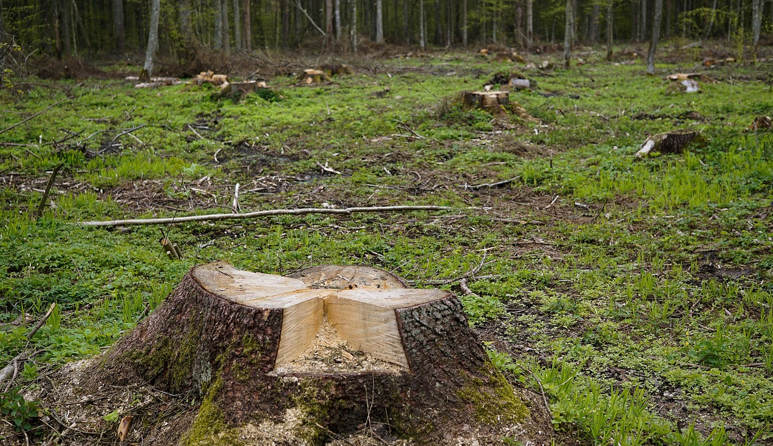
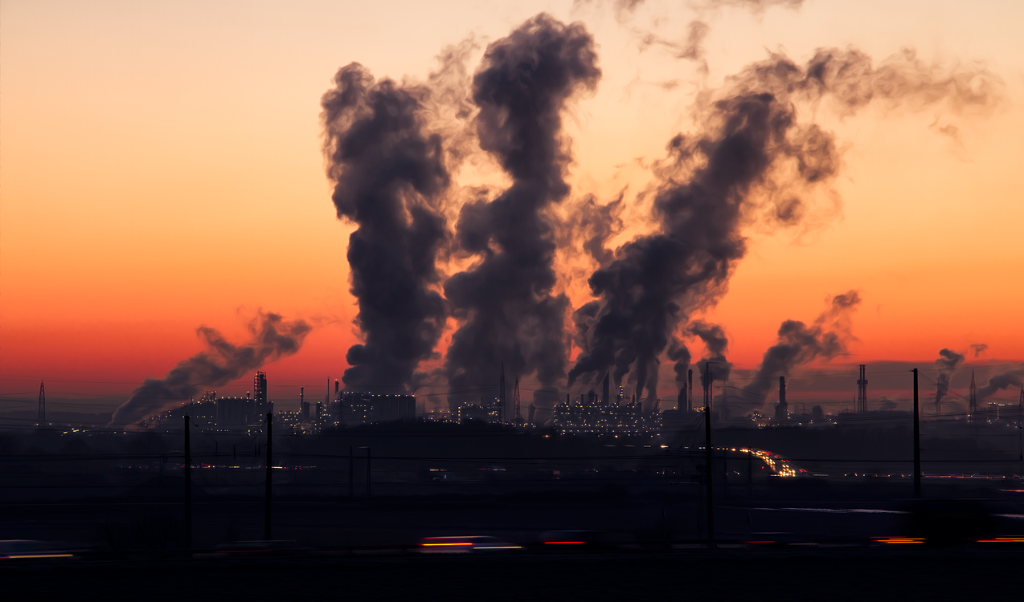
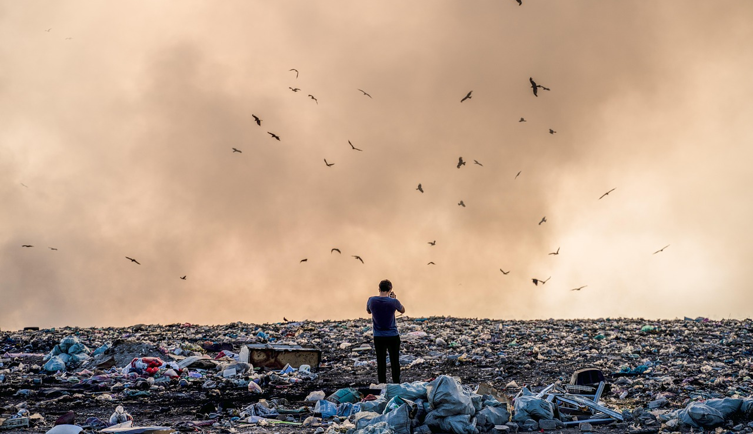
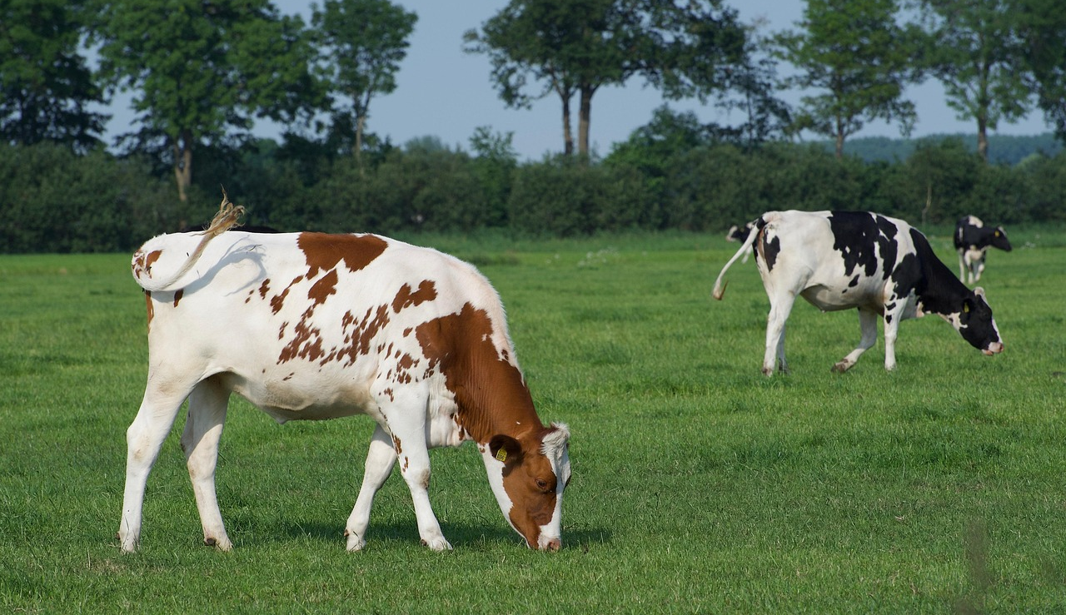

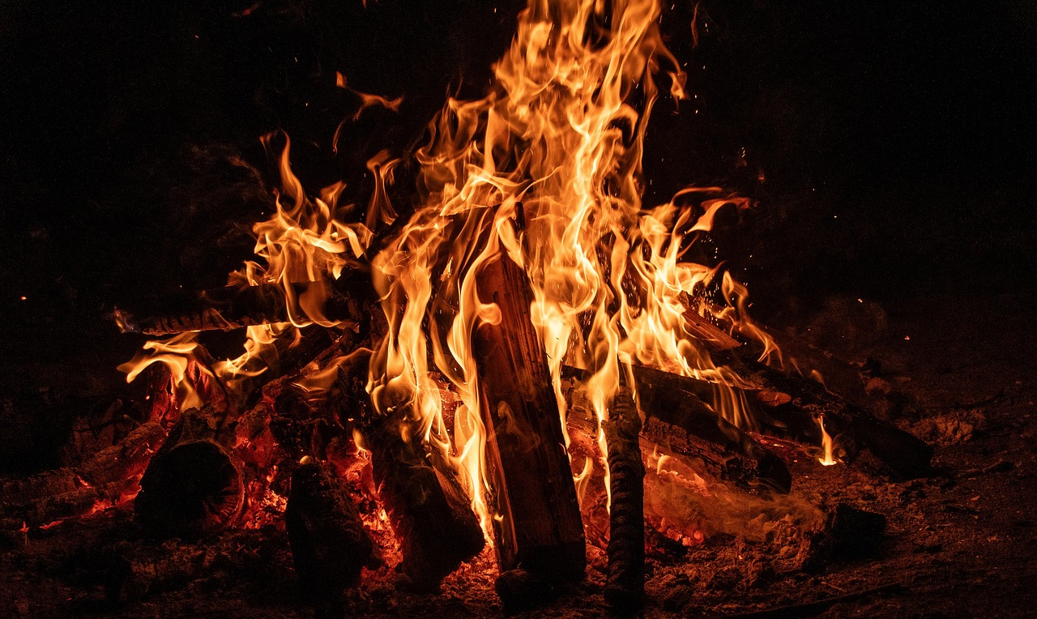
Today, we are going to be Pollution Investigators!
Take a look at these pictures. What do you notice?

Slide 3

What is Air Pollution?
Air pollution occurs when toxic substances are released into the air. This damages our health. ​
​
The air we breathe in every day is polluted. Some causes of air pollution are:
fumes from motor vehicles and factories​
campfires and coal burners​
Some types of farming practices​

Slide 4
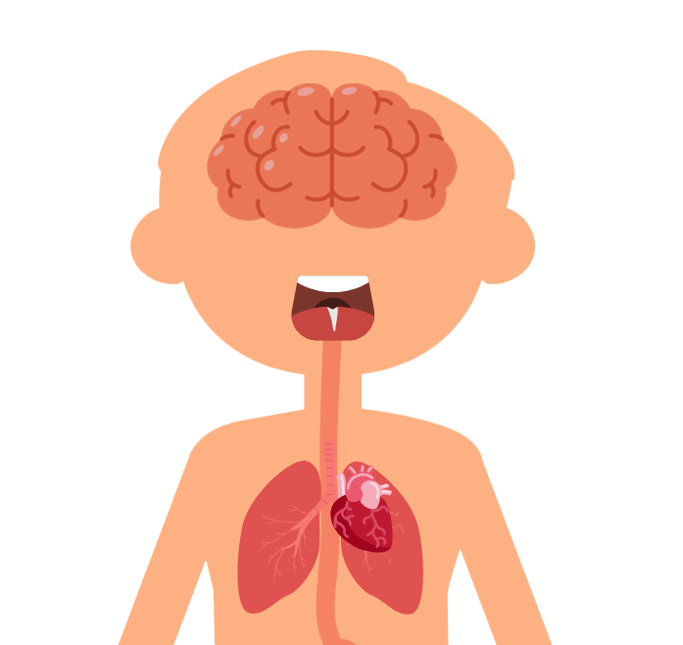
Air pollution is bad for everyone's health but can be particularly harmful for people with lung conditions, like asthma. ​
​
Air pollution can affect all parts of our bodies but especially our hearts, lungs and brains. It can be worse for children because your organs are still growing and developing!

Slide 5
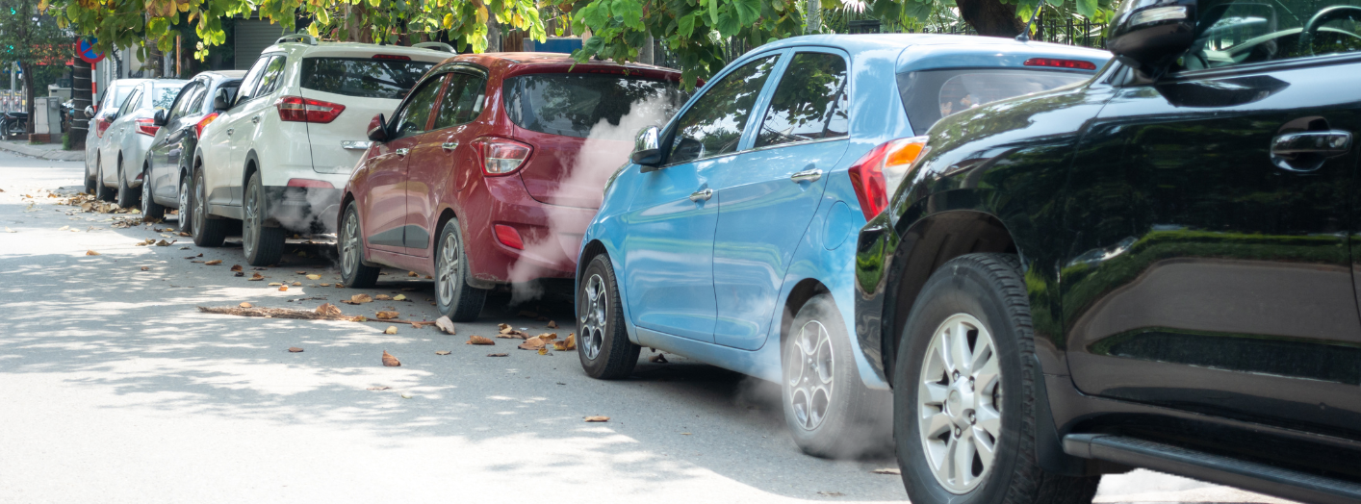

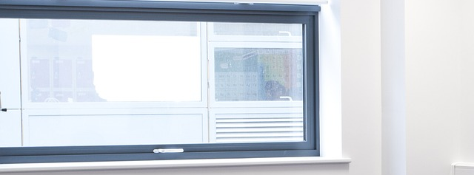
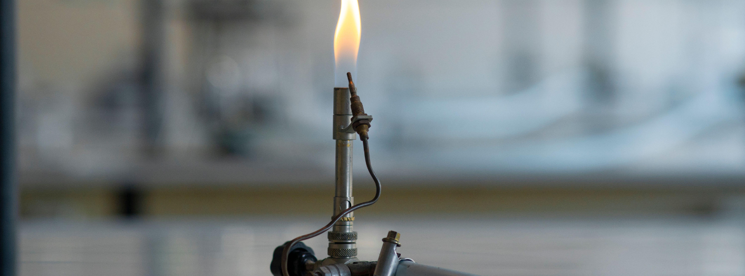
What Causes Air Pollution around Schools?

Slide 6


Sunnyfield Primary School
This is Sunnyfield Primary School.
Your task today is to investigate an area of the school or its grounds and report on the air quality, providing a recommendation for how it can be improved.

Slide 7

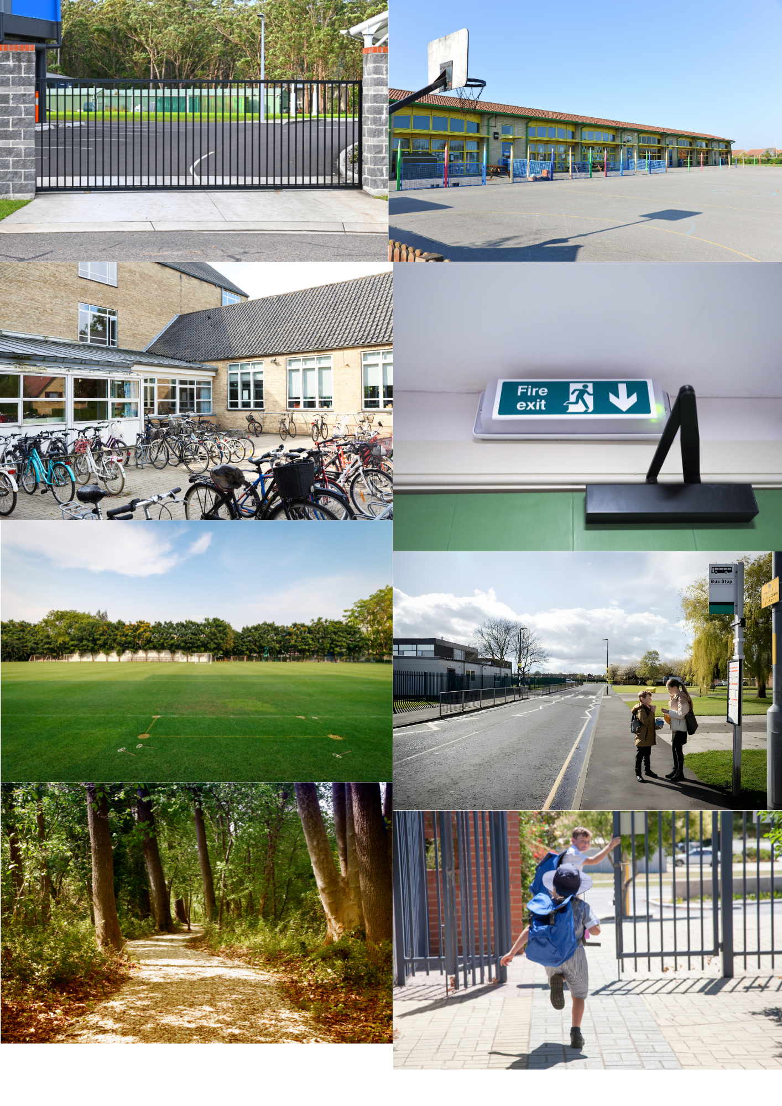
For your given area, read the scenario and think about what could be done to improve the air quality. Using the sheet, prepare a report for the class.
Main Gate
Bike Racks
Playground
Sports Field
Fire Exit
After School Club
Forest
Bus Stop

Slide 8

Report Time
In your group, present your findings to the class. ​
​
What are your recommendations for improving the air quality at Sunnyfield Primary?

Slide 9

Play Your Part!
We all have a part to play in improving the air we breathe. ​
Remind your parents and carers to switch off their engines when stopped.
Walk, scoot or cycle to school instead of driving. ​
Remind adults at school to open windows when they can so we can breathe in fresh air. ​
Try to spend time in nature.

Slide 10
We're All in This Together​
Asthma + Lung UK do lots of work to spread awareness about air pollution. ​
​
But they can't do it alone. ​
​
Help them spread the word about things we can all do to help breathe cleaner air.

